Slide 1



Chapter 14
APA
Communications
Guidelines
@ 2012 Wadsworth, Cengage Learning

Slide 2
Topics
Writing Clearly
Avoiding Grammatical Problems
Reporting Numbers
Citing and Referencing

Slide 3
Topics (cont’d.)
Typing and Word Processing
Organizing the Paper
APA Formatting Checklist
Conference Presentations

Slide 4
Writing Clearly

Slide 5
Writing Clearly
Guidelines:
  Orderly presentation of ideas
    Prepare an outline
  Smoothness of expression
    Provide transitions
    Do not change topics suddenly
  Economy of expression

Slide 6
Writing Clearly (cont’d.)
Strategies:
  Write from an outline
  Put aside the first draft, then reread it after a delay
  Ask a colleague to critique the draft

Slide 7
Avoiding Grammatical Problems

Slide 8
Avoiding Grammatical Problems
Check for subject and verb agreement
A pronoun must agree with its antecedent
Pronouns must agree in gender with the nouns they replace
Understand the proper use of homophones
Use active voice

Slide 9
Reporting Numbers

Slide 10
Reporting Numbers
Use words
  When expressing numbers below 10 that do not represent precise measurements
Use numerals
  For all numbers 10 and higher

Slide 11
Reporting Numbers (cont’d.)
Some exceptions:
  When starting a sentence with a number, use words
  When starting a sentence with a number, use words
  When reporting a percentage, use numerals followed by a percent sign
  When describing ages, use numerals
  When describing sample size, use numerals

Slide 12
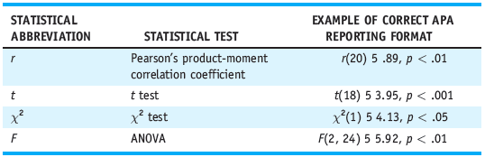
Reporting Numbers (cont’d.)
Table 14.1 Statistical Abbreviations and Examples of Correct APA Format for Reporting Test Results

Slide 13
Citing and Referencing

Slide 14
Citing and Referencing
Any information obtained from another source must be cited and referenced
Author-date method of citation
  When the name of the author appears as part of the text, cite the year of publication in parentheses
  When the name of the author is not part of the narrative, both the author and the date appear in parentheses, separated by a comma

Slide 15
Citing and Referencing (cont’d.)
Multiple authors
  When a work has two authors, cite both authors every time the reference occurs
  When a work has three to five authors, cite all authors the first time the reference occurs
  After that, cite only the first author’s surname followed by the abbreviation “et al.”
When in doubt about referencing format
  Consult the APA Publication Manual (2009)

Slide 16
Typing and Word Processing

Slide 17
Typing and Word Processing
Double-spaced
12-point font size in a serif style
At least 1 inch margins
Justify the left margin
Use two spaces after periods

Slide 18
Organizing the Paper

Slide 19
Organizing the Paper
Title page
  A title should summarize the main idea
  Below the title of the paper is the author’s name, and below that is his or her institutional affiliation
  Author notes
Abstract
  Brief summary of the contents
  Between 150 and 250 words

Slide 20
Organizing the Paper (cont’d.)
Introduction
  First part introduces the problem under study
  Second part contains previous relevant research
  Third part states the purpose and rationale
Method
  Describes exactly how the study was conducted
  Most common subsections:
    Participants
    Procedure

Slide 21
Organizing the Paper (cont’d.)
Results
  Summarizes the data collected and the type of statistic(s) used
  Description of the results only
  Use tables and figures
Discussion
  Allows you to evaluate and interpret the results
  Can be combined with the results section

Slide 22
Organizing the Paper (cont’d.)
References
  Any works cited in the text must appear in the references
Appendices
  Used to provide information that might be distracting if presented in the text
Tables and figures
  Tables always precede figures

Slide 23
Organizing the Paper (cont’d.)
APA-style papers use one to five levels of headings
Most papers will use Level 1 through Level 3 headings
  Level 1 headings: used for major sections
  Level 2 headings: used to divide the major sections into subsections
  Level 3 headings: used to organize material within a subsection

Slide 24
APA Formatting Checklist

Slide 25
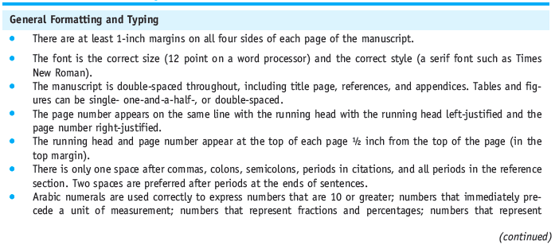
APA Formatting Checklist
Table 14.3 APA Formatting Checklist

Slide 26
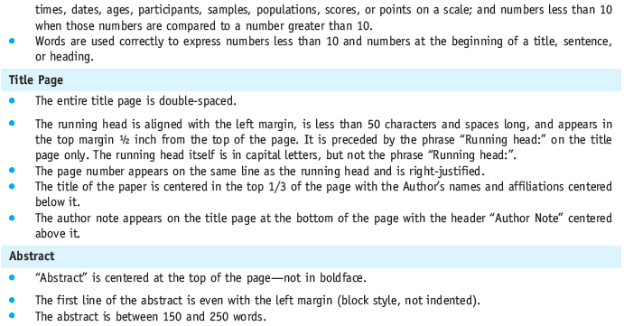
Table 14.3 APA Formatting Checklist (cont’d.)

Slide 27
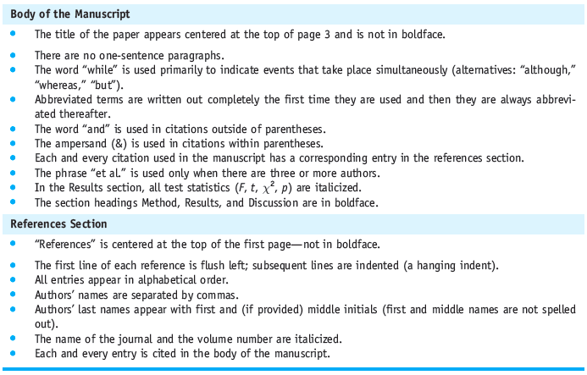

Table 14.3 APA Formatting Checklist (cont’d.)

Slide 28
Conference Presentations

Slide 29
Oral Presentations
10 to 15 minutes
Decide on a limited number of ideas
Use simple language free of jargon
Consider using transparencies, slides, or PowerPoint slides
Write your presentation out

Slide 30
Oral Presentations (cont’d.)
Practice delivering your presentation
When you actually deliver the paper, do not read it
Leave time for questions
Have copies ready for distribution (APA, 2001a)

Slide 31
Poster Presentations
Opportunity for the presenter and the audience to talk with one another
Minimize jargon
Use pictures, tables, and figures
Use an appropriate font size
Have copies of your paper ready for distribution

Slide 32
Summary
APA’s writing standards
APA formatting and writing guidelines
Organization of an APA-style manuscript
Presenting your research at conferences
  Oral presentation format
  Poster presentation format

